Slide 1


Operationalization of Food, Nutrition, Health and WASH (FNHW) interventions through
Self Help Groups and its Federations
Facilitator’s Orientation on
Functions of CLF/VO- SAC/OB/EC
National Mission Management Unit, Deendayal Antyodaya Yojana – National Rural Livelihoods Mission (DAY-NRLM)
Ministry of Rural Development, Government of India

Slide 2
List of content
Why integrate FNHW- rationale and context of Dashahsutra strategy
Overview of State FNHW Operational Strategy
Implementation structure for operationalization of FNHW
Roles and Responsibilities of CLF/VO SAC
Implementation of Key FNHW Activities- Operational components
Implementation of Key FNHW Activities- Programmatic components
Available resource material and how to use?

Slide 3





Why integrate FNHW?
Proper Nutrition

Health Services

Increased savings
Overall wellbeing and improved quality of life
Appropriate Sanitation and Hygiene
Less Expenditure on Health/Diseases

Slide 4
Advisories on FNHW integration
In 2016- an advisory on Dashasutra mandating FNHW integration
FNHW integration
reduces expenditure on medical care
increases economic productivity
improves the quality of life of rural women and their families
In 2017- a Master Circular on FNHW (link below) to outline FNHW interventions
In 2018- Joint advisory by MoWCD, MoRD and MoHFW to guide modalities of convergence
In 2020- An advisory to strengthen Social Behaviour Change Communication approaches for improved FNHW outcomes
In 2020- An advisory to guide development of State FNHW Operational Strategy and functions of SRLM staff and cadres

Slide 5
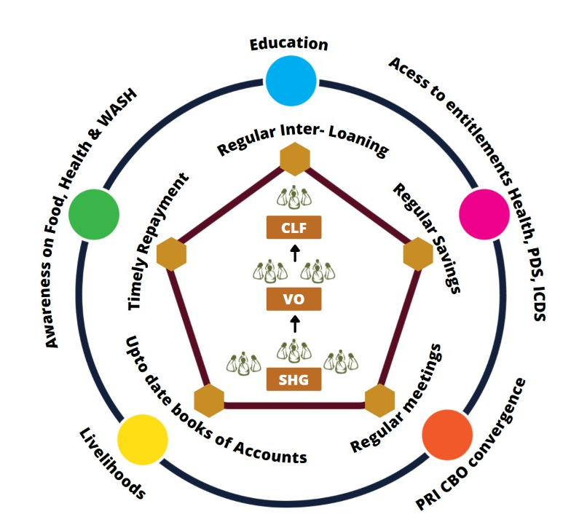
Dashasutra Strategy- 2016
Integrating livelihoods and social development for holistic growth of communities
Micro-credit and financing
Including social development - Food, Nutrition, Health and WASH, Gender etc.

Slide 6



FNHW Focus Areas
FOOD
Nutri-Garden
Access to PDS
Access to THR
Mid Day Meal
FNHW Enterprises
HEALTH & NUTRITION
Antenatal Care | Anemia reduction
New Born Care | Family Planning
1000 Days | Health & Nutrition for the Elderly and PWD
Infant and Young Child Feeding | Nutrition and Health during NCDs
Maternal Nutrition | Menstrual Hygiene
Family Diet diversity
WASH
Use of sanitary toilet
Handwashing practices
Management of household waste

Slide 7
Strategic Pillars
System Strengthening
  To improve ability of the system to integrate FNHW
Convergence
  Facilitate convergence between Health, WCD and PRI etc. for improved service delivery
SBCC
  Promote behavior change among SHGs
FNHW Enterprises
  Promote establishment of FNHW enterprises managed by SHGs

Slide 8
Overview of State FNHW Operational Strategy
Next few slides (9-13) are specific to State FNHW Operational Strategy. State Managers are expected to fill in the desired information.

Slide 9
State Profile and Identification of FNHW Geographies
State map depicting FNHW geographies (Districts)
State name
 | Total | NRETP | NRLM
No. of Districts
No. of Blocks
No. of CLFs No. of VOs No. of SHGs
Source: *Census, 2011

Slide 10
District Profile
District map depicting FNHW geographies (CLFs)
District name
Population*
Literacy Rate*
Sex Ratio*
 | Total | NRETP | NRLM
No. of Blocks
No. of CLFs No. of VOs No. of SHGs
Source: *Census, 2011

Slide 11
District Profile- Key FNHW indicators
Key Health Indicators of State and Focus District
Key highlights
Depict through graph
Key Nutrition Indicators of State and Focus District
Depict through graph
Source: NFHS 5, 2019-20

Slide 12
FNHW Synthesis from State Operational Strategy
3. Goal
4. Objectives
5. Clientele/Target Group

Slide 13
Key interventions to be implemented as per State FNHW Operational Strategy

Slide 14
Implementation Structure for Operationalization of FNHW
SHG Level HR
VO Level HR
CLF Level HR
State Mission Management Unit
District Mission Management Unit
State Programme Manager SI & SD
Program Manager, State Resource Person/Master Trainers
District Programme Manager IB-CB, District resource pool
Block Mission Management Unit
Social Action Committee (consisting 5 members)
Office Bearers/ Executive Committee
Block Programme Manager, resource pool
Social Action Committee (consisting of 3 members)
Community Resource Person (CRP)
FNHW Nodal(Community Mobilizer/Active Woman etc.)
Note: The above implementation structure is suggestive. States may modify this as per their State FNHW Operational Strategy.

Slide 15
Roles and Responsibilities of CLF and VO
Under the leadership of CLF EC, CLF SAC members (along with Office Bearer) will anchor FNHW implementation at CLF level.
Under the leadership of VO EC, VO SAC (along with FNHW Community Resource Person) members will anchor FNHW implementation at VO level.
EC/SAC/OB members at CLF and VO level need to be orientated on key FNHW interventions and operational mechanics
Nodals at both the levels need to clearly understand
  their roles
  specific FNHW interventions to be implemented in their respective areas
  timelines
Note: The information in this slide is suggestive. States may modify this as per their State FNHW Operational Strategy.

Slide 16

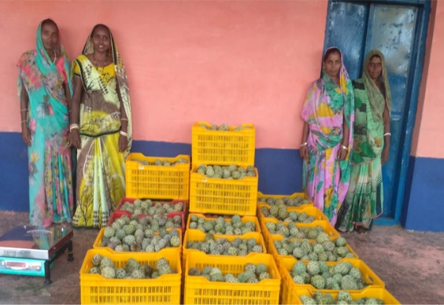
Roles and responsibilities at CLF level
CLF SAC members
CLF OB/EC members
Develop FNHW Action Plan
Coordinate with BMMU for FNHW related information/ guidance
Review performance of VO SAC committee
Collate all VO reports and compile to submit to block
Undertake frequent monitoring visits to assess VO for FNHW activities
Grade VOs based on their FNHW performance
Release payment of CRP/FNHW cadre based on performance review
Hold regular meetings with functionaries of line departments (ANM, Anganwadi Supervisor, PRI member etc.)
Support in establishment of reward mechanism for CLF/VO/SHG
Upward and downward coordination for establishment of FNHW enterprises
Facilitate release, monitor utilization and augmentation of Vulnerability Reduction Fund
  Participate in POSHAN Abhiyaan/POSHAN Pakhwada and other events

Slide 17
Roles and responsibilities at VO level
Develop Annual FNHW Action Plan
Review FNHW progress at VO level
Support FNHW CRP to implement FNHW interventions in rolling out of FNHW interventions:
Rollout FNHW sessions during monthly meetings
Organize VO level Community events/campaigns
Undertake home-visit/peer counselling
Participate in VHSND planning, provide support in making VHSND more community friendly and mobilize SHGs
Monitor progress of SHGs on FNHW activities
Represent SHG members at community forums/committees (VHSNC/Gram Sabhas)
Coordinate convergence with village level frontline functionaries (ASHA and AWW) and representatives of line departments (PRI etc.)
Mobilize target groups to participate in VO level events
Undertake Vulnerability Reduction Planning including VRF augmentation for SHG members
Collate SHG level reports of interventions and report to the CLF Level
Support to establish reward mechanism
  Participate in POSHAN Abhiyaan/POSHAN Pakhwada and other events

Slide 18
Implementation of Key FNHW Activities- Operational components

Slide 19
Develop FNHW Action Plan
A clearly articulated plan helps to better implement the envisaged activities and achieve identified targets.
Objectives
To be able to adopt a systematic process to develop the action plan
To identify and prioritize areas of implementation
To list out the tasks/activities
To decide on timelines of identified activities
Action plans developed at Village Organization (VO) and Cluster Level Federation (CLF) level, will guide the on-ground FNHW implementation.
At VO level- CRP/VO SAC will lead this process with support from atleast one representative of each SHG in the same VO
At CLF level- CLF SAC will lead this process with support from atleast one representative of each VO in the same CLF

Slide 20
Steps to be followed
Devote at least three hours for this exercise
Decide a suitable time and date
Prepare action plan with monthly and quarterly breakups.
Prioritize list of activities based on operational feasibility of the activity within the CLF and its importance for the CLF.
Have clearly defined timelines
Review action plan regularly
Refer slide 46 and 47 for formats
Note: All activities envisaged under FNHW state operational strategy must be conducted.

Slide 21
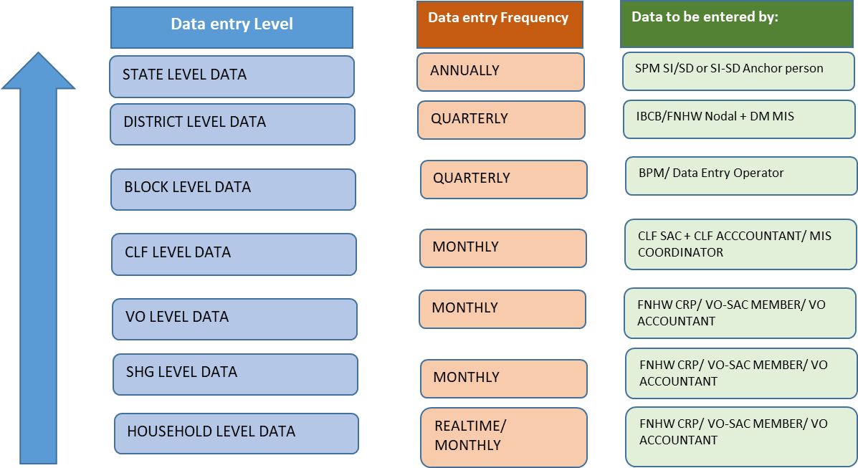
MIS and Reporting of FNHW
Reporting Mechanism

Slide 22
MIS and Reporting of FNHW
Suggested Indicators
# | Indicators
Progress of FNHW Interventions | Progress of FNHW Interventions
1 | # of target beneficiaries in SHG HHs in the reporting month (pregnant women/lactating women/adolescents/elderly etc.) | No. of CLFs initiated FNHW activities
2 | % SHGs conducted monthly meeting on FNHW | No. of SHGs conducted monthly meeting on FNHW
3 | % SHGs oriented on FNHW modules | No. of SHGs oriented on FNHW modules
4 | % SHG women oriented on FNHW modules | No. of SHG member households having functional toilet
5 | % VOs organized community events on FNHW (campaigns/rallys/competitions etc.) | No. of VOs having trained cadre on FNHW
6 | % VOs participated in VHSNC/JAS/RKS meeting | No. of VO-SAC participated in VHSND
7 | # of VO running an FNHW enterprise | No. of VOs conducted community events on FNHW
Include any other indicator as synthesized in State FNHW Operational Strategy
Ensure quality of data reported in MIS

Slide 23
Review FNHW activities
FNHW agenda should be included in the regularly scheduled review meetings
A separate dedicated FNHW meeting should be held at state/district/block/CLF/VO level.
Objectives
To assess progress of activities against timelines
To acknowledge and share positive accomplishments
To identify and confront the flaws in performance or processes
To identify challenges and suggest course corrections
Schedule for review
Level | Undertaken by | Participants | Frequency
Block | Block Program Manager (FNHW Incharge) | CLF Leader/ SAC Members/OB/EC | Monthly
CLF | CLF Leader/SAC Members/OB/EC | VO Leader/SAC Members/CRP | Monthly
VO | VO Leader/SAC Members/CRP | SHG Leaders/Point person | Monthly
Note: States may modify the schedule and protocol based on their State implementation structure.

Slide 24
Steps to be followed
Conduct on a monthly basis
Review progress against the activities listed in FNHW Action Plan
prepared by the CLF and VO.
Review activities for their progress, adherence to timelines, adherence to pre-decided protocols/processes, any challenge faced, potential solutions and course corrections
Use CLF/VO level FNHW Activity Review formats
Discuss actions points to be taken
Take into account the previous month’s Action Taken Report
Refer slide 48 and 49 for formats
Remember: Review is NOT a fault finding exercise

Slide 25
Convergence
Coordinate with functionaries of line departments (Health, WCD and PRI etc.) to improve uptake of FNHW services and entitlements.
Objectives
To identify areas of convergence and prominent issues therein
To prioritize issues and suggest mitigating measures
To identify relevant stakeholders and assign responsibility
To decide on a timeframe for resolution and escalate issues
Schedule for Convergence
Level | Undertaken by | Participants | Frequency
Block | Block Program Manager (FNHW Incharge) | Block-level representatives from line departments | Quarterly
CLF | CLF Leader /SAC/OB/EC | Supervisor and ANM, PRI members | Quarterly
VO | SAC/CRP | ANMS, ASHA and AWW, PRI | Monthly
Note: States may modify the schedule and protocol based on their State implementation structure.

Slide 26

Steps to be followed
Organize convergence meeting as per the suggested frequency
Inform all the concerned participants in advance
Use CLF/VO level convergence meeting formats
Identify convergence issue and suggest specific actions and discuss with stakeholders
Assign responsibility to relevant department for corrective action
Persistent/higher order issues may be escalated
Record minutes of the meeting and share
Refer slide 50 and 51 for formats

Slide 27
Possible areas of Convergence
Focus areas | Within DAY-NRLM | With other departments/ministries
Food and Nutrition | Farm Livelihoods Nutri-garden/poultry/goatary Non-Farm Livelihood FNHW enterprises | Department of Food and Public Distribution System Public Distribution System (PDS) Department of Women and Child Development Integrated Child Development Services- Take Home ration (THR), growth monitoring and Early childhood care and pre-school education, POSHAN Abhiyaan Pradhan Mantri Matru Vandana Yojna (PMMVY) Department of Education Mid Day Meal (MDM) Mahatma Gandhi National Rural Employment Guarantee Scheme (MGNREGS)
Health | Financial Inclusion Access to health/life/accident insurance Institution Building-Capacity Building Use of Vulnerability Reduction fund (VRF) | Department of Health and Family Welfare National Health Mission- Anaemia Mukt Bharat, Village health Sanitation and Nutrition Days (VHSND), Universal Immunization Program (UIP), Surakshit Matritva Aashwaasan (SUMAN), Pradhan Mantri Surakshit Matritva Abhiyaan (PMSMA), Janani Suraksha Yojna (JSY), Janani Shishu Suraksha Karyakram (JSSK) Ayushman Bharat- Health and Wellness Centre and Pradhan Mantri Jan Arogya Yojna (PMJAY) Ministry of Finance Pradhan Mantri Suraksha Bima yojna (PMSBY)
WASH | Financial Inclusion SHGs take loans for WASH activities | Swachh Bharat Mission Toilet construction Solid liquid waste management Jal Jeevan Mission
Adapted from Master Circular for FNHW

Slide 28
Implementation of Key FNHW Activities- Programmatic components

Slide 29
Please note that it is NOT necessary that all interventions discussed here will be implemented………
FNHW interventions as identified in State FNHW Operational Strategy will be implemented only……

Slide 30
1. Roll out of FNHW Sessions during Monthly Meetings
Role of VO
Provide handholding support to facilitator in FNHW session rollout during SHG meetings
Support in logistics arrangement for trainings and rollout
Mobilize specific target groups (e.g. adolescent girls and newly weds etc) for FNHW sessions
Coordinate with AWW/ASHA for participation in relevant sessions
Role of CLF
Finalize training plan and undertake training of facilitators to rollout FNHW sessions
Support in logistics arrangement for trainings and rollout
Provide handholding support to facilitator in FNHW session rollout during SHG meetings
FNHW session should be chosen based on to prioritized themes, for phase wise rollout as described in State FNHW Operational Strategy.

Slide 31



Suggested Cascade for FNHW Capacity Building
Material developed:
Facilitator's Guide for CRPs/MTs
Flip Books for rollout during SHG meetings
Mater Trainers (NMMU, Partners, NIRD, NRP)
1
SRP
DRP
BRP
SIRD
State level Trainers
2
Master Trainers
Master Trainers
Community level Trainers
3
Community Resource Persons
CLF/VO leaders/SAC members/OB/EC
Community cadre/Active women
This training cascade is suggestive. This can be modified depending upon state implementation structure.
4
Trainers of SHG members
SHG women

Slide 32
2. Participation of Village Organizations in VHSND
Be a formal member of VHSNC/JAS and regularly participate in VHSNC meeting
Participate in monthly VHSND planning and coordination meeting (led by ANM supported by ASHA)
Identify support areas for VHSND such as-
  Support in maintaining privacy during ANC, prioritizing beneficiaries for early registration
  Mobilize identified target group on the day of VHSND to avail due services
Provide support in organization of VHSND activities
Provide support to ANM/ASHA/AWW:
Coordinate with ANM for immunization and ANC requirements of SHG members
Coordinate with ASHA and prepare due list of SHG target groups and mobilize on the day of VHSND
Coordinate with AWW for mobilization of SHG households for child growth monitoring, THR distribution and nutrition counselling
Refer slide 52 for format

Slide 33
3. How to conduct a home-visit?
Home visits for FNHW are to be undertaken by Community Resource Person (CRP)/VO-Social Action Committee (SAC) members in the households of target beneficiaries.
Objectives
To counsel the target beneficiaries and their families to adopt appropriate FNHW behaviours
To make families aware of existing FNHW services and provide support in linking them with FNHW schemes and entitlements
To ensure compliance to appropriate FNHW behaviours and provide support required by the target groups/family
To mobilize target beneficiaries to access FNHW services and entitlements, including those delivered at Anganwadi and VHSND platforms

Slide 34
Steps to follow
Process
Identification of target groups and micro-planning for home visit
  Line-list the target beneficiaries
  Develop a monthly micro-plan to conduct home visits
Undertake home visit
  Use home visit checklist to understand the current status of utilization of FNHW services and entitlements by the beneficiary.
  Conduct counselling in presence of other family members
Do monthly reporting
Who will conduct?
Community Resource Person (CRP)/VO-SAC
What items to be carried during home-visits?
Counselling cards
Home visit checklist
Note: It is advisable that these home visits be undertaken in conjunction with ASHA/AWW for more impact.
Refer slide 53-56 for formats

Slide 35
4. How to conduct peer counselling at SHG households?
Peer counselling- When counselling services are provided by SHG groups/peers to the target beneficiaries and their family members.
Objectives
To counsel target beneficiaries and their families, especially the influencers/decision makers of the family (for example-male members and elders) to adopt appropriate FNHW behaviours
To reiterate key messages in presence of influencers and provide support to the family in linking with FNHW services and entitlements
To mobilize the influencers/decision makers of the family particularly male members to care and provide support to target group in accessing FNHW services and entitlements

Slide 36
Steps to follow
Who will conduct?
Led by SHG leader, along with the entire group.
A peer who practiced recommended FNHW behaviours and achieved desired outcomes
Other beneficiaries of the similar target group from the same SHG community can be called at the SHG household.
Identification of target groups and micro-planning for peer counselling
  Line-list the target beneficiaries
  Develop a monthly micro-plan to conduct peer counselling at SHG households
Undertake peer counselling
  Use peer counselling checklist to understand the current status of utilization of FNHW services and entitlements by the beneficiary.
  Depending upon the presence of family, undertake either before or after monthly FNHW meeting is over.
Do monthly reporting
It is suggested that CRP/VO-SAC members should be present during these meetings for initial handholding.
What items to be carried during peer counselling?
Counselling cards
Peer counselling checklist
Refer slide 57 and 58 for formats

Slide 37
5. Steps to organize FNHW Community Event/Campaign
Organize events or campaigns, at community level, on key FNHW themes
Adopting following approaches:
One-time event (community event)
Series of events in continuation over a few days in the form of a campaign (community campaign)
Objectives
To create enabling environment involving all stakeholder for better uptake of FNHW behaviours by the community as a whole
To reach people outside of the SHG fold through community mobilization effort
To identify community level champions to take forwards FNHW agenda in the community
To facilitate synergies with the efforts of other line departments (e.g.- POSHAN Maah, POSHAN Pakhwada, Swachhta Abhiyaan etc.)

Slide 38
Key points for planning the event/campaign
Focus on key FNHW components identified by the DAY-NRLM and in sync with State FNHW Operational Strategy.
Must be organized for a day/ a few days across all the blocks of all the districts across state.
Organize at a monthly/quarterly frequency.
VO to lead organization of such events/campaigns through its cadre of CRP/SAC.
Should be participated by all the beneficiaries of the identified target group and their family members.
Sync these events/campaigns with the ones organized by other line departments to create synergies and have more impact.

Slide 39
Steps to follow
Before community event
  Line listing of beneficiaries
  Deciding the date and venue
  Planning for type of activities
  Home visit
On the day of event
  Organize the planned activities as per decided schedule
  Mobilize target beneficiaries, community and representatives from other line departments
  Reward for the winners of competitions if organized.
  Identify and coordinate in advance for having open remarks from local dignitary.
  Plan schedule of event in coordination with VO SAC
  Arrange for refreshment and water
  Ensure cleanliness of the venue, toilet facility arrangement, arrangement of durries.
Follow-up after the event
Do reporting in the standard format
Refer slide 59-63 for formats

Slide 40
Please refer Standard Operating Procedures Booklet for details on all components….
For imparting detailed understanding on specific components (such as- how to conduct FNHW action planning, review or convergence), states may plan a separate hands-on trainings as required.

Slide 41
Introduction to National FNHW Resource Package

Slide 42
Themes under National FNHW Resource package
1. Linkages with livelihoods and FNHW
2. Malnutrition cycle and first 1000 days
3. Antenatal care
4. Maternal nutrition
5. Care of the newborn
6. Infant and Young Child Feeding (IYCF)
7. Balanced and diverse diet for the family
8. Nutri-gardens
9. Public Distribution System/Take Home Ration
10. Anaemia
11. Hygiene related behaviours
12. Family planning
13. Adolescent nutrition and health
14. Menstrual hygiene and related behaviours
15. Management of waste at home
16. Nutrition and health for the elderly
17. Non Communicable Diseases (NCDs) 18. Women’s health issues

Slide 43
List of resource materials
Standard Operating Procedure Booklet- to provide detailed guidance on operational and programmatic components
Facilitator Guide for Trainer- to facilitate trainers in rolling out sessions on FNHW
Flipbooks for Trainers to use during SHG meetings
IEC Materials for home visits, community events, etc.
  Posters – for display during community events and awareness generation
  Banners – for events like campaigns and rallies
  Stickers – to serve as reminders on key messages
  Counselling Cards – to be used during home visits and smaller interactions
Presentations for orientation of state/district/block managers and CLF/VO level SAC members
Use of package is subjected to prioritizing themes, contextualizing, translation, phase wise use and implementing as per State FNHW Operational Strategy.

Slide 44



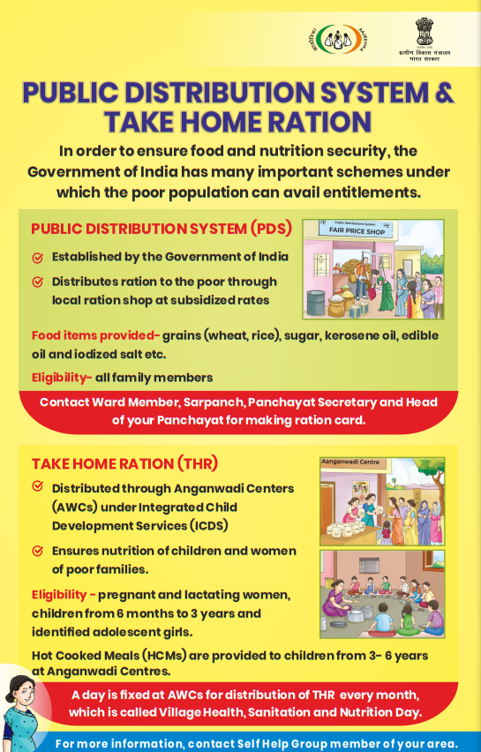
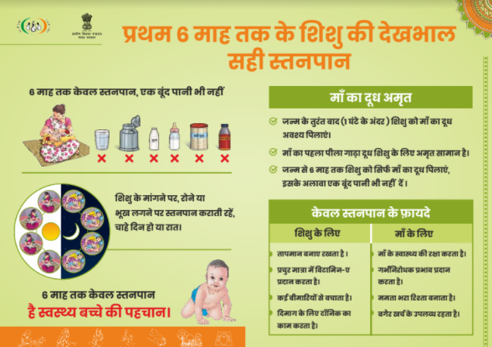

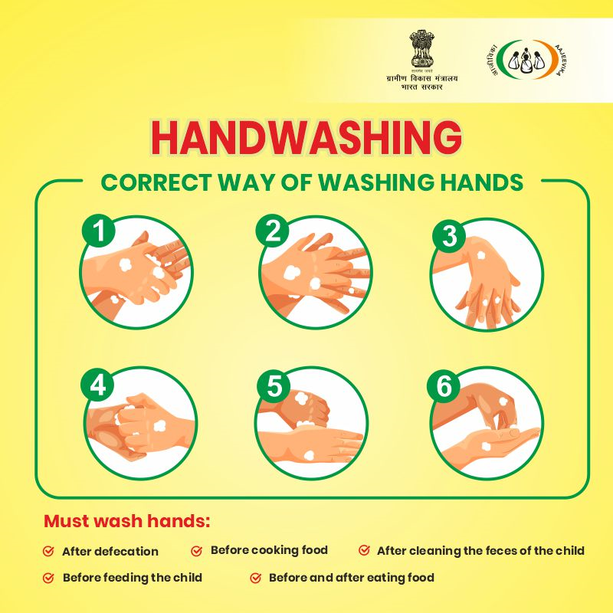
Sample of materials developed to support FNHW integration

Slide 45
Annexures

Slide 64
Thankyou

